Slide 1
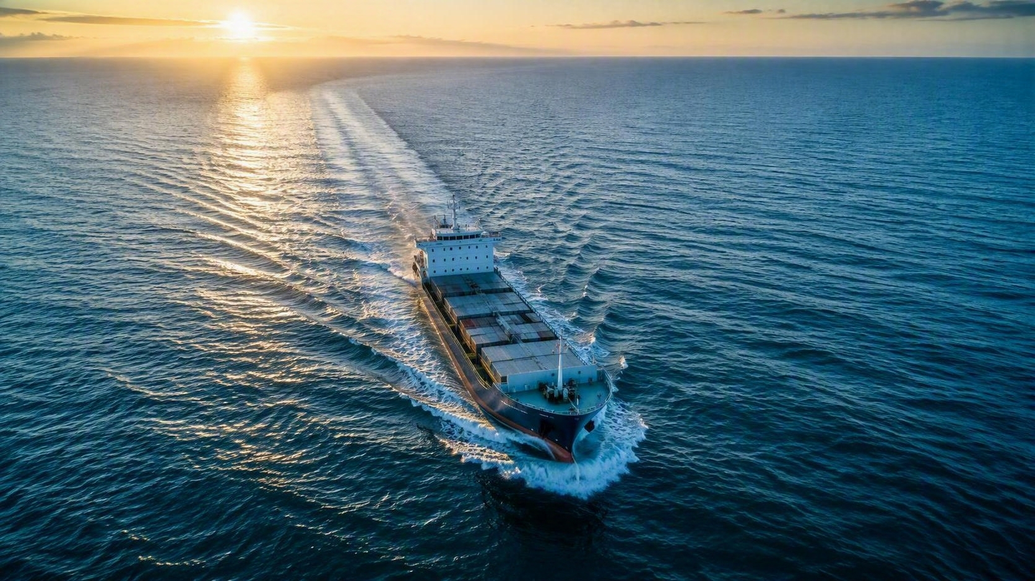
2025
Sustainability
Report

Slide 2

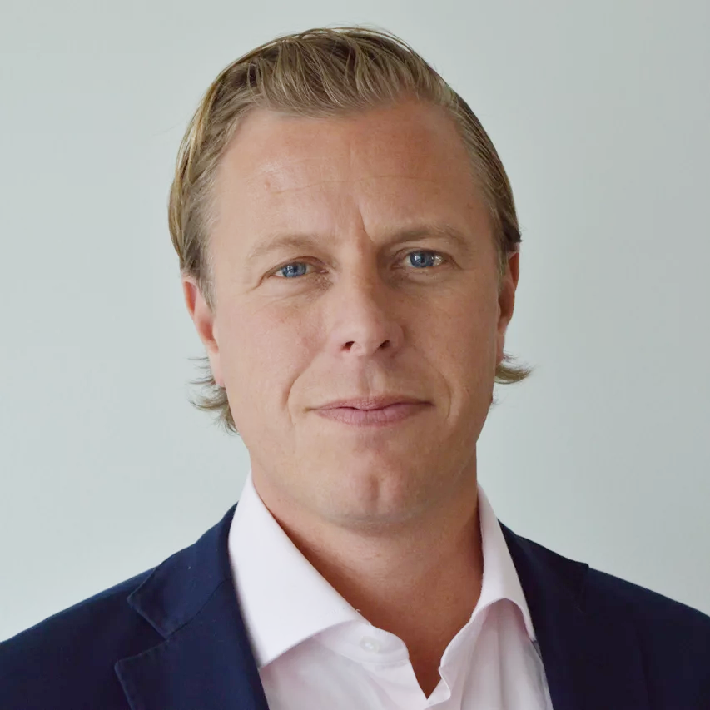
Words from the CEO
As we reflect on 2025, I am proud of the steady progress we continue to make on our journey toward a more sustainable future. In a year marked by ongoing uncertainty and change, maintaining a clear direction and continuing to move forward with consistency has been essential.
Our commitment to responsible forwarding, efficient terminal operations, and environmentally conscious short sea shipping remains strong. Sustainability is an integrated part of how we operate and how we take responsibility within the logistics sector.
During the year, we continued to strengthen our responsible supply chain management by increasing transparency and engaging with suppliers on sustainability performance. We also reached an important milestone of net zero offices by reducing emissions where possible and climate‑compensating the remaining CO₂ emissions . This is an important step forward, while we continue to address emissions across our broader operations over time.
People and safety remain fundamental priorities. We are therefore particularly proud that no workplace accidents occured for the second consecutive year, reflecting our continued focus on a safe and healthy working environment.
In uncertain times, meaningful progress requires steady commitment and a long-term perspective. By continuing to take deliberate steps forward, we build resilience and a solid foundation for the future.
Thank you for being part of this journey.
Eric Hjalmarsson, CEO

Slide 3
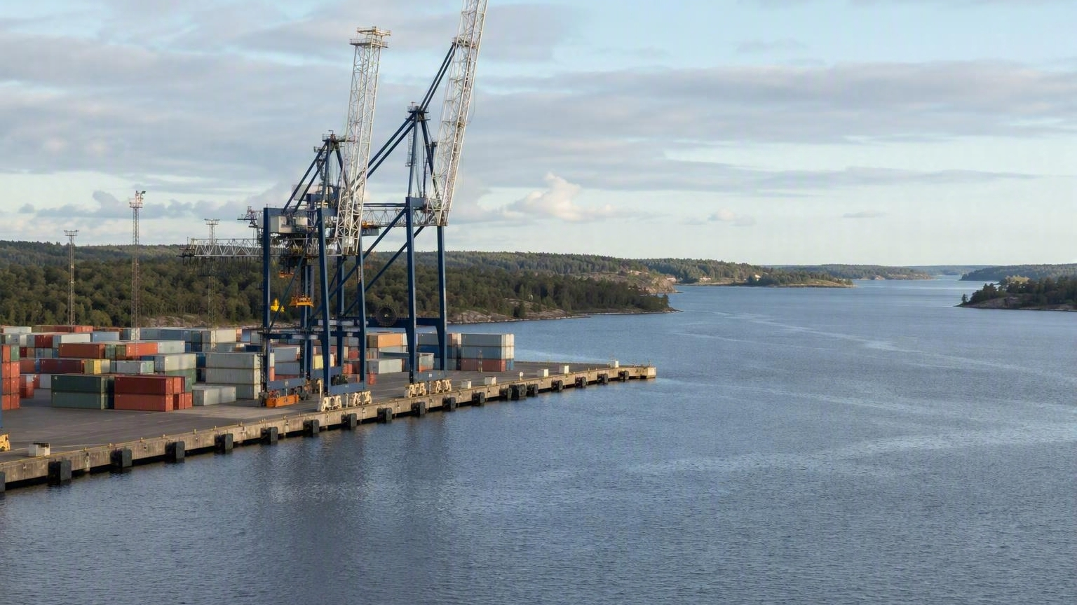

About TSG
TSG was founded in 1994 and has eight offices in Sweden and two offices in the UK at the end of 2025 with an annual turnover of >900 MSEK.
UMEÅ/HOLMSUND
Mission
TSG is a customer focused and personal logistics company that has specialized in tailormade, door-to-door solutions. Our services combine shipping, storage, forwarding and customs clearance services with sustainable end-to-end solutions for freight owners worldwide.
SÖDERHAMN
GÄVLE
VÄSTERÅS
SÖDERTÄLJE
Organisation
TSG had approximately 80 employees with 8 offices in Sweden, in addition to Goole and Hull in the UK.
OXELÖSUND
OSKARSHAMN
GOOLE
HULL
Business Areas
Global Forwarding – Serving customers world-wide with Forwarding solutions including warehousing, project cargo handling and agency.
Short Sea – Sustainable shipments on our own liner service by sea, connecting Sweden, UK and Benelux .
Terminal Operations – Flexible and bespoke terminal and warehousing services for breakbulk and container handling in the UK.
HELSINGBORG
Sustainable logistics
that take your business
all the way.

Slide 4

Our Sustainability Strategy
01

Slide 5







Double materiality
analysis and
sustainability strategy
Sustainability has been a priority for TSG for several years. In 2024, we updated our double materiality assessment, with support from external experts, to identify and assess TSG’s material impacts, risks, and opportunities (IROs) in line with regulatory requirements and industry standards.
The assessment confirmed the continued materiality of our three focus areas, representing the areas with the most significant impacts on our business and on society. These focus areas were therefore reaffirmed as relevant and continued to guide our sustainability strategy and priorities in 2025.
  2025 focus areas
  Minimising climate impact.
  Employee health and safety
  Sustainable supply chain
  including workers in the value chain

Slide 6
Sustainibility aspects and focus areas
Minimising climate impact
Employee health and safety
Sustainable supply chain, including workers in the value chain
FOCUS
Prolong equipment lifespan and enable recycling
IT security and handling of personal data
Minimize impact on water and marine ecosystems
DEVELOP
Promote diversity, equality & inclusion
Career opportunities and development
Maintain low levels of air pollution
Maintain good business ethics and work
with anti-corruption
Contribution to local communities
Dealing with hazardous goods
MANAGE & MONITOR

Slide 7
Objectives and key focus areas
7
Strategic objectives | Minimize consumption of resources Preserve aquatic ecosystems | Safe working environments for own employees and subsuppliers | Trusted partner by all stakeholders
Current key focus area | Minimizing climate impact | Employee health and safety | Sustainable supply chain, including workers in the value chain
Key performance indicators 2025 | GHG emissions per tkm for the liner service HVO systematically offered to customers for road transport | No lost time incidents and accidents in the year | Increase the share of suppliers whose contracts reference the Supplier Code of Conduct
Environment
Social
Governance

Slide 8

Risks & Opportunities
2025 has continued to be shaped by geopolitical uncertainty and rapid transformation across the logistics industry. Our assessment of risks and opportunities remains robust and has been further reinforced. Sustainability efforts are increasingly proving to be both a critical risk mitigation tool and a central driver of long-term growth, resilience, and value creation for our stakeholders.
Opportunities
We see an opportunity to shift cargo from road to sea, thereby decreasing the emissions per tonne kilometers
Electrification of our terminal operations
A new generation of vessels in our liner service with new propulsion technologies
We shorten the last leg for inland distribution by calling ports close to end-customers
Evaluate and partner with our suppliers to implement low emission technologies and good governance practices in the value chain
Create internal skills development and career opportunities as our business grows and diversifies
Risks
Climate change increases risks for operations, as turbulent weather increases in frequency, and of business disruptions, as customer and regulatory demands increase on the logistics sector
Our personnel and suppliers operate in hazardous environments on the
terminal and vessels, meaning we need to maintain the highest health-
and-safety standards
Cyber and other security risks is affecting operations and security
of transportation and data integrity across the industry
Accidents with our vessels could have high impacts on the local marine environment where we operate
There is a constant risk that our transport services are misused for criminal activities such as smuggling

Slide 9
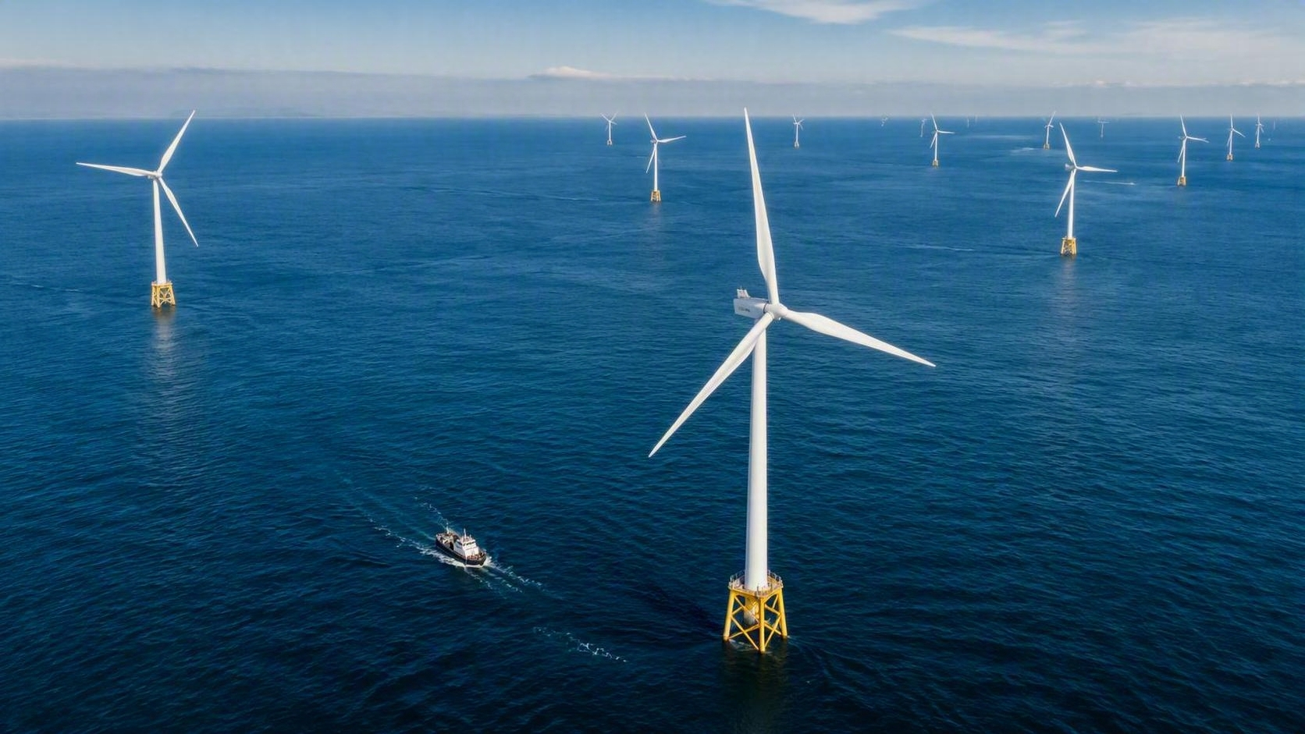
Minimize climate
impact and other enviromental targets
02

Slide 10
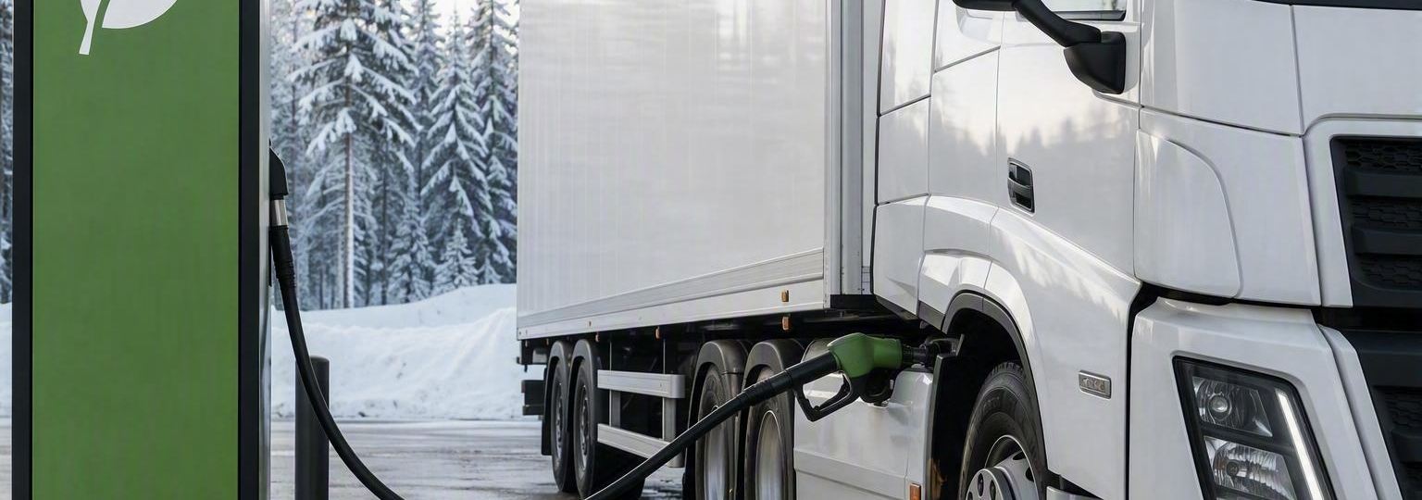
3rd party transport solutions
A central part of our strategy is to choose carriers that work towards fossil-free alternatives for our forwarding and last mile services. By prioritizing these suppliers, we show our commitment to reducing the environmental impact of transportation. We strive to shift the 3rd party transport solutions towards environmentally friendly alternatives as the technologies and markets mature. We have continued to offer HVO as an option, enabling a a sharp reduction of GHG also for the road transports for our customers.
Our shipping services
We offer sea transport of goods between the east coast of Sweden, England and Benelux. With the capacity of the vessels, we can transport large volumes of goods on each shipment, which leads to a reduction in emission values per transported unit compared to traditional road transport as shown in our KPI of CO2e g/tkm.

Slide 11

Fleet & water management
We act according to the international standards and rules set for the shipping industry. Ballast water management is managed according to IMO standards and involves methods that minimize the risk of damaging the underwater environments and ecosystems where our ships operate.
Energy consumption & recycling
We strive to reduce our climate impact in every way we can, both in the logistics chain, in the offices and in the terminal operations. Our equipment must be used responsibly during its lifetime and when disposed of it must be recycled to enable circular reuse whenever possible.
In 2025, we achieved the milestone of net zero offices by eliminating GHG where possible and climate compensating for the rest. Going into 2026, we will continue focusing on measuring, minimizing and totally eliminating GHG emissions and waste in the sectors of our operations where this is possible.

Slide 12
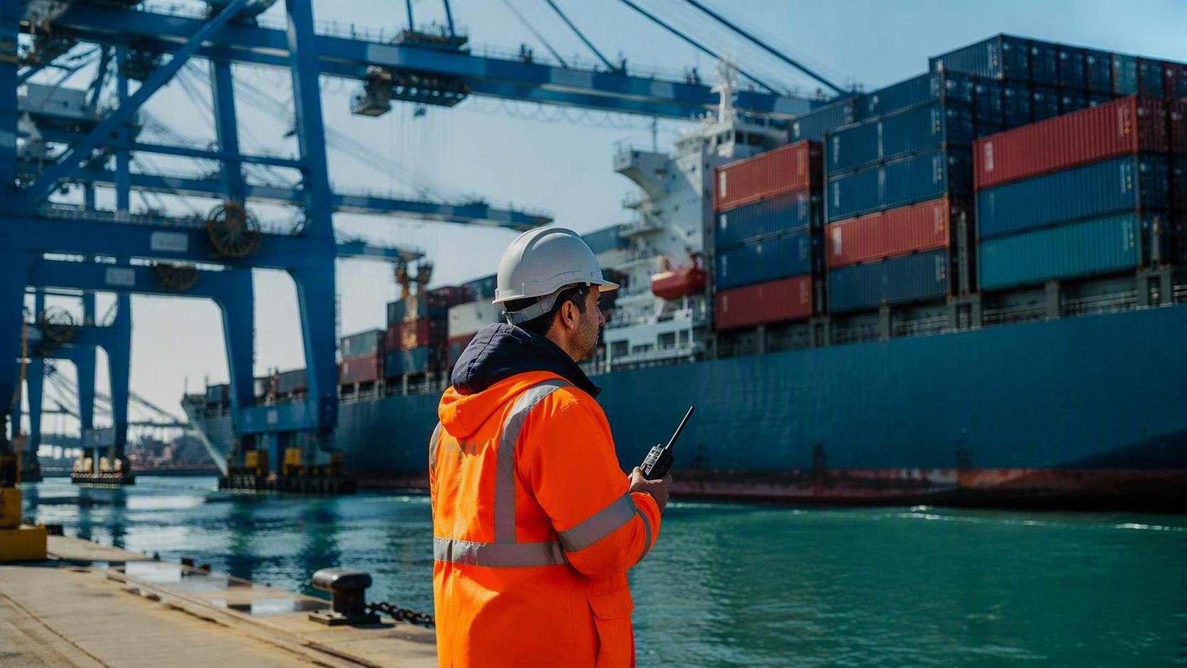





Achieve net zero offices in 2025
Climate impact ambitions for 2025
Achieved
TSG greenhouse gas emissions
for all vessels to be below
11.64 g CO2e/tonne-km for the year
TSG achieved 12,23 g CO2e/tonne-km due to less cargo in the year. Still considerably better than road trailer transport (appr 80g/tonne-km*) but room for improvement going into 2026.
* Using UK BEIS/DEFRA conversion factors

Slide 13
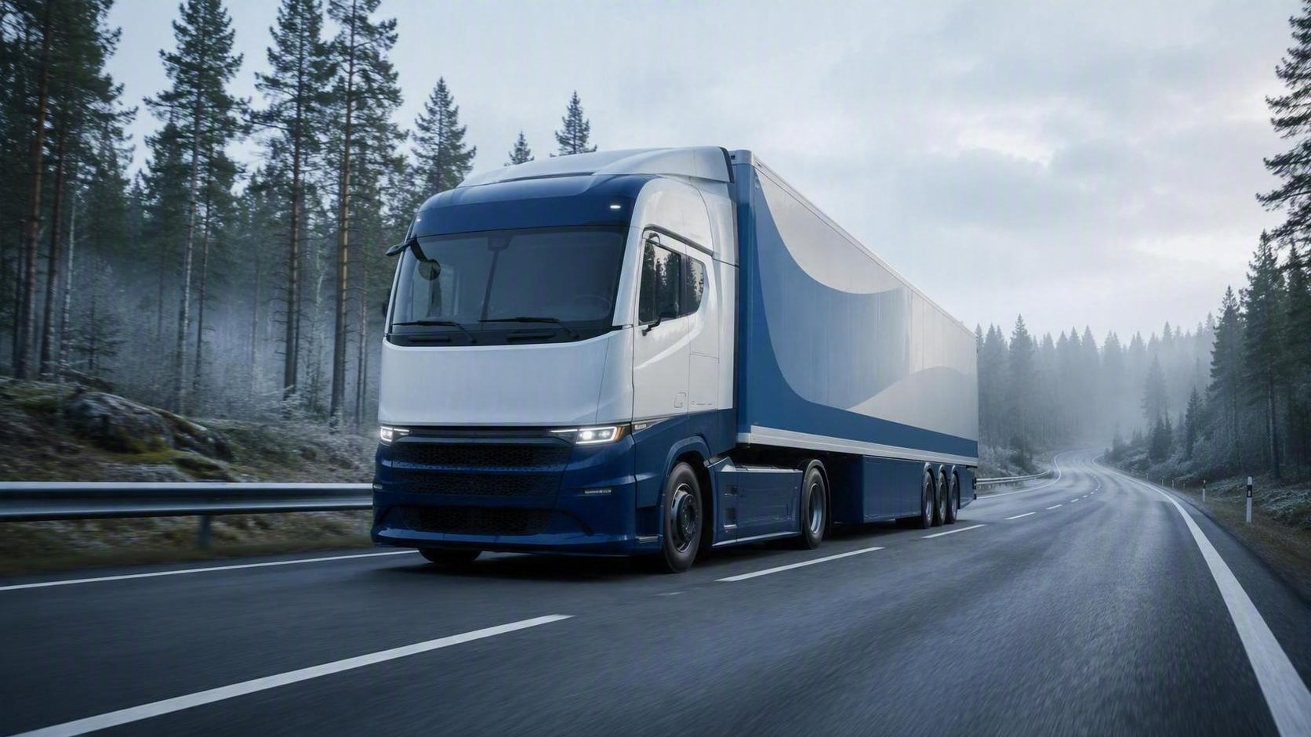
Road Ahead: Minimize climate
impact and other enviromental targets
Net Zero Terminal operations by 2030
Fleet renewal for carbon free Short Sea transports
Transition to carbon free technologies in 3rd party transport solutions
Pushing ahead into 2026 and onwards
Achieving the net zero offices in 2025 we will now focus our efforts on achieving the net zero terminal operations by continuing our efforts to introduce electric fork trucks etc.
Meanwhile, we are continuously exploring our options to introduce carbon free technology in our wider logistics offering.

Slide 14
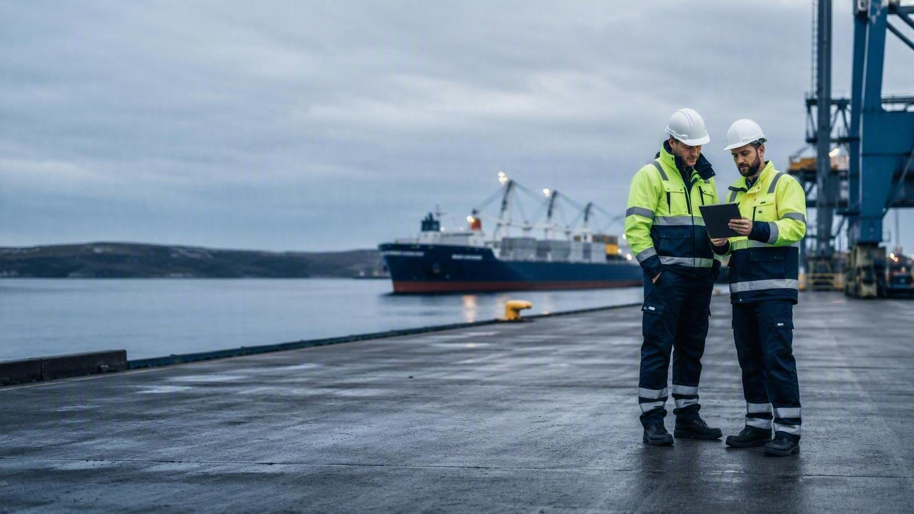
Social Sustainability
03

Slide 15
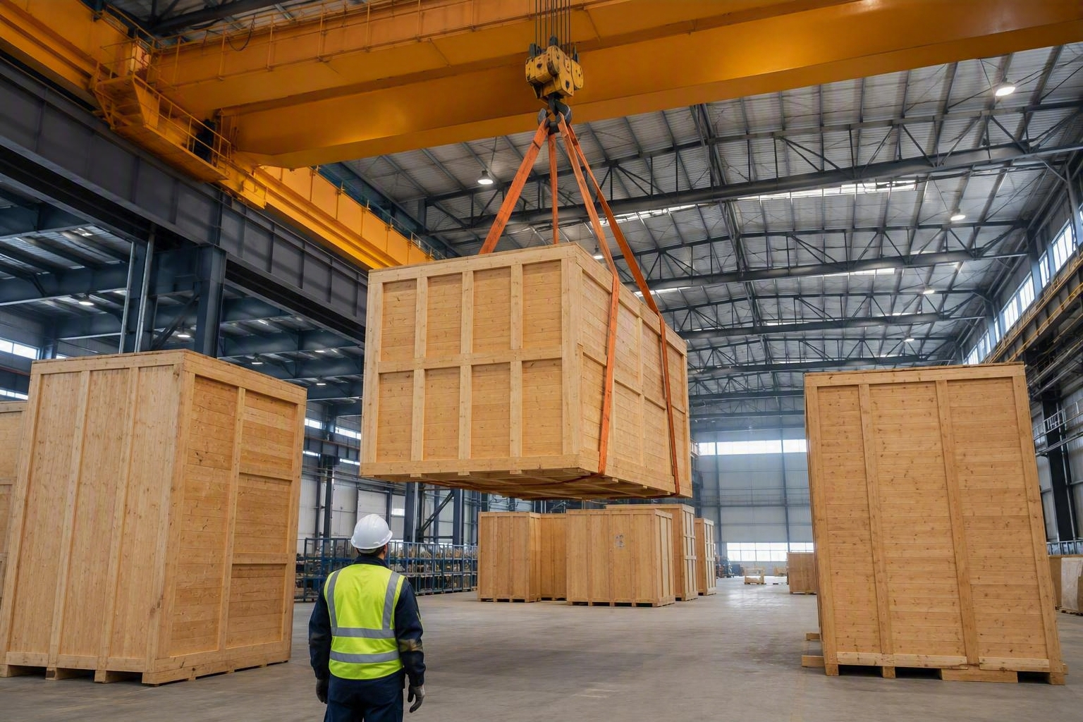


No work-place accidents or lost time incidents in the year
Achieved
TSG is determined to keep our employees and workers in the value chain safe, especially when working in dangerous environments like the sea-going vessels and terminals. We continuously work to monitor and improve our work environment and cooperate with our suppliers to ensure everybody goes home safely.
We wish to give our employees the right competencies to develop with the company through continuous and relevant trainings.
Local outreach
TSG strives to be an active and responsible part
of our local communities. We achieve this by sponsoring activities of local sports teams, social charities and being active members in the local chambers of commerce.
TSG also has a special commitment to trade schools in the regions where we are present. We continuously offer internships to student, give lectures as part of the educational programmes and are proud to use them as a primary recruitment channel.
Training and career development
TSG is quickly evolving together with the whole logistics sector. We wish to give our employees the right competencies to develop with the company through continuous and applicable trainings.
Workers in the value chain
Our Supplier Code of Conduct is being rolled out among our suppliers, requiring among other things good working conditions for all employees in the value chain. The rollout is carried out in close cooperation with our responsible and trusted long-term partners.

Slide 16

Road Ahead: Social Sustainability
Maintain high standards of H&S and no Lost Time Incidents
Continued roll-out of Supplier Code of Conduct as part of supplier contract
Continue being a caring employer
and member of society
Going forward, we will strive the maintain our strong performance in Health and Safety with the goal to not havev any Lost Time Incidents in the organisation by encouraging risk reporting, performing regular risk reviews and esnuring that all employees have the right training for their tasks. We will further make the Supplier Code of Conduct into an integral part of our supplier contracts to make adherence compulsory and more stringent, ensuring that all workers in our value chain are safe and have good working conditions.

Slide 17

Governance
04

Slide 18

Governance
TSG conducts business with high integrity. This means that all employees are expected to perform their duties in an honest and responsible manner with high ethics and morals. We promote a culture of respect and fairness, ensuring that all stakeholders of our company are treated with respect and professionalism from management and co-workers and expect the same in return.
Code of Conduct
Our code of conduct guides our employees to follow our values, detailing our expectations of high ethical standards in dealing with external and internal partners and co-workers.
Supplier Code of Conduct
Through our supplier code of conduct we communicate expectations around the environment, work environment, human rights and corruption.
By choosing carriers that maintain good working conditions throughout the supply chain, we send a clear message about our commitment to promoting fairness and dignity in the transportation industry.
Our ambition for 2025 was to start measuring the rollout of our SCoC, beginning with the Forwarding suppliers – 34% spend coverage achieved
TSG adheres to national and international agreements, conventions, laws, regulations, trade practices, and good practices.

Slide 19

19
Whistleblower System
Violations or suspected crimes and other violations of our code of conduct can be reported anonymously via our whistleblower system are followed up and investigated by an external partner together with a notification committee appointed by the board.
Anti-corruption
We do not accept or allow bribes, abuse of power, unfair compensation, cartel formation or actions that may inhibit the free market.
Compliance of Goods
The goods flow we manage for our customers shall be compliant with all applicable regulations. In case of suspicion of a violation of this, TSG cooperates with the Customs authorities and other relevant bodies. All crew and port staff moving on the ships must be ISPS qualified, and the procedures for checking staff on duty are strict. Unauthorized arrivals are dealt with according to international law and contact with local authorities is made immediately.
Cyber Security
TSG recognizes the increased threat of cyber security breaches for customers and other stakeholders and is covered by NIS 2 regulation. In 2025 we continued with regular cyber security training for our staff and a close cooperation with our IT suppliers to maintain high-standards of cyber security.

Slide 20




Road Ahead: Governance
Continued Cyber Security testing and certifications
Continued roll-out of Supplier Code of Conduct as part of supplier contract
ISO certification Terminal 2026/2027
Consider further ISO certifications
Certifications & Standards
TSG is a certified AEO agent, we adhere to the IMO D-2 standard for ballast water handling and follow the ISPS code for port security.
Our Global Forwarding and Short Sea businesses are ISO 9001 and ISO 14001 certified. In 2025, we began the process of ISO-certifying the Terminal business under the same standards. The process will continue with the aim of conclusion in 2026 or early 2027.
Strengthen our governance infrastructure
Going forward, we will seek to strengthen the governance infrastructure even further, especially in the areas of Cyber Security and the application of the Supplier Code of Contact as well as finalizing the ISO 14001/9001 certification of the Group by rolling in also the Terminal. Beyond this, we will consider the certifications that will provide the most assurance and value to our customers and other stakeholders as we continonusly improve the way we operate.

Slide 21

Thank you for your interest in our Sustainability Report 2025. If you have any further questions don’t hesitate to contact us.
tsg.se
tsgterminal.com
© Copyright 2025, TSG – ThorSvecon Group of companies. All rights reserved

